Slide 1
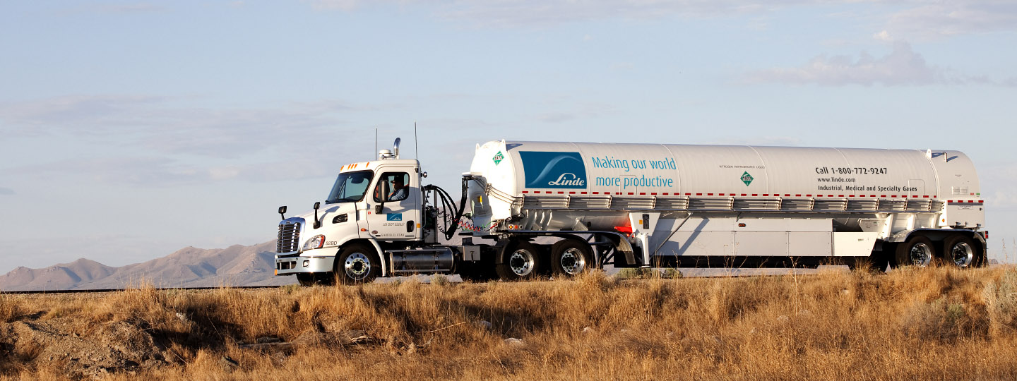
S/4 HANA Migration SAP ECC - Mexico
Feb 2025
Rodolfo Ortiz

Slide 2
Agenda
S/4 HANA Migration SAP ECC - Mexico
Purpose
What is SAP ECC Mexico?
Mexico Modules, Landscape & Connecting Systems
Mexico Roles

Slide 3

Purpose
S/4 HANA Migration SAP ECC - Mexico
Provide an overview of SAP ECC and how Linde Mexico is using SAP Modules to meet business objectives.

Slide 4
What is SAP ECC Mexico?
S/4 HANA Migration SAP ECC - Mexico
SAP ECC Mexico landscape:
D?? Development System
S2E Quality Assurance System
P2E Production System

Slide 5
S/4 HANA Migration SAP ECC - Mexico
Active Company Codes
MX02 CNC MX80 CNC - IFRS GAAP
MX82 CNC - US GAAP
MX11 Sonitsa MX83 Sonitsa - IFRS GAAP
MX81 CONSA – IFRS GAAP
Inactive Company Codes
MX03 Consa
MX04 Linde Hidrogeno
MX10 Servicios
MX12 Funica
MX14 BOC Gases de Mexico
MX84 Funica - IFRS GAAP

Slide 6

SAP ECC Modules
Plant Maintenance
Materials Management
Finance
Mat. Master
PM
AP/AR
Materials Management
Controlling
Inventory
CO
Materials Management
Reporting?
Sales & Distribution
Purchasing

Slide 7
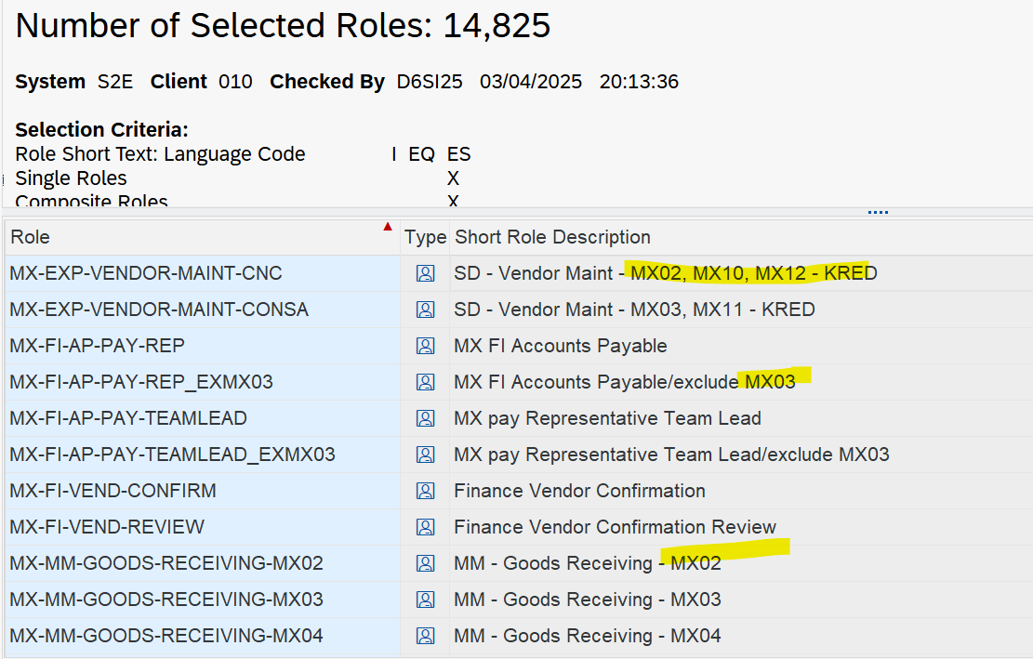
SAP ECC Mexico Roles (Functional Roles)

Slide 8
Additional Activities for Mexico?
S/4 HANA Migration SAP ECC - Mexico
Pending Activities

Slide 9

Thank you
March 10, 2025
9

Slide 10














Project S/4 HANA US & Mexico – Scoping Key Systems
Draft
Sales
Operation & Distribution
Procurement
Finance
CX
Satellite applications
Interface
Core systems
Reporting
SAP Data Feeds
Paragon
Cevinio
LINX
TrackAbout Cylinder Mgmt
IHistorian
GOLD
Tbc – RfP in progress
TEMS (All)
eChannel
SalesForce CRM, CIM, CLM, aPp@L (homecare)
Web Apps (e.g. PRS [Price Review System])
Bank Interfaces (All) & C2FO (IN)
SRM (All)
SAP PI/PO, RFC or Flat file, winshuttle (local)
SAP
✓
SAP BI/BW & Informatica output
TM1
✓
✓
✓
Regional App
Global App

Slide 11
Project S/4 HANA US & Mexico
System Landscape
ECC
DGE
S2E
P2E
Current Operational Landscape
System Copy prior to each migration *
Source
Project
Landscape
SRC1/SxP
SRC2/SyP
Retrofit
Data Migration
Data Migration
PMG
Box 1
Box 2
Box 3
Box 2
Go Live
TM0/SxA
(Tech. Tests)
TM1/SyA
(SIT)
TM2/Q2A
(UAT)
GLS/SyA
(Simulation)
Control Sys
Target
Go Live
Transport Catch Up
S/4
D2A
Q2A
P2A
Future Operational Landscape
* For SDT, the source must be kept frozen until data is validated; hence copy of P2E

